Slide 1


Slide 2

Requirement
Definition of requirement
  The first stage of software development which defines what the potential users want the system to do. In modern methods these requirements should be testable, and will usually be traceable in later development stages. A common feature of nearly all software is that the requirements change during its lifetime.
  A condition or capability to which a system must conform
  The set of functions, performance measures, and constraints that software must satisfy.

Slide 3
Functional requirements
Describe functionality or system services
Specify actions that a system must be able to perform, without taking physical constraints into consideration
Depend on the type of software, expected users and the type of system where the software is used
Functional user requirements may be high-level statements of what the system should do but functional system requirements should describe the system services in detail

Slide 4
Examples of functional requirements
The user shall be able to search either all of the initial set of databases or select a subset from it.
The system shall provide appropriate viewers for the user to read documents in the document store.
Every order shall be allocated a unique identifier (ORDER_ID) which the user shall be able to copy to the account’s permanent storage area.

Slide 5
Non-functional requirements
Define system properties and constraints e.g. reliability, response time and storage requirements. Constraints are I/O device capability, system representations, etc.
Non-functional requirements are not directly concerned with the specific functions delivered by the system.
Process requirements may also be specified mandating a particular CASE system, programming language or development method
Non-functional requirements may be more critical than functional requirements. If these are not met, the system is useless

Slide 6
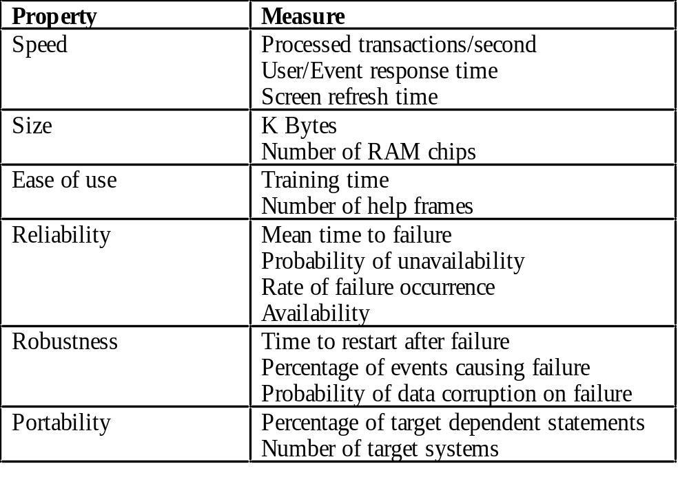
Examples Of Non-Functional Req.

Slide 7

Types of Non-functional requirements
Product – product behavior
Organizational – policies and procedures
External – requirements derived from factors external to system and development process
    Interoperability
    Legislative
    Ethical

Slide 8


Requirements Engineering
Definition:
  Requirements engineering process provides the appropriate mechanism for understanding what the customer wants, analyzing need, assessing feasibility, negotiating a reasonable solution, specifying the solution unambiguously, validating the specification and managing the requirements as they are transformed into an operational system[THA97]

Slide 9
Goal
Requirements engineering goal is to define requirements of a product by documenting,analyzing and design and implement the desired product.

Slide 10
Requirements engineering methods enable unambiguous, complete and consistent documentation for requirements and functional editing during the first phase of systems design.

Slide 11
Five distinct steps
Requirements elicitation
Requirements analysis and negotiation
Requirements specification
System modeling
Requirements validation
Requirements management

Slide 12
Elicitation — determining what the customer requires
Analysis & negotiation — understanding the relationships among various customer requirements and shaping those relationships to achieve a successful result
Requirements specification — building a tangible model of requirements

Slide 13
System Modeling — building a representation of requirements that can be assessed for correctness, completeness, and consistency
Validation — reviewing the model
Management — identify, control and track requirements and the changes that will be made to them

Slide 14
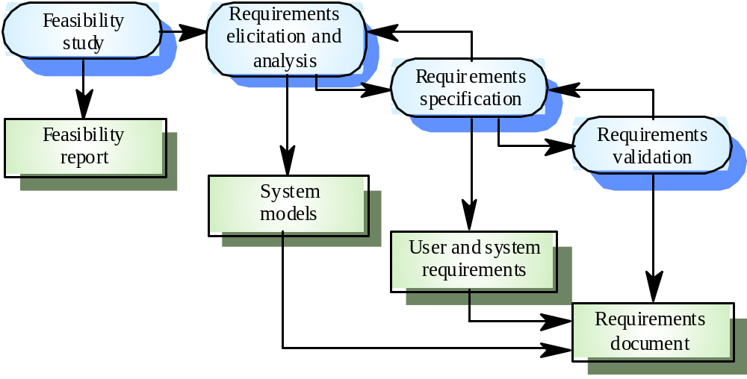
Requirements Engineering process

Slide 15
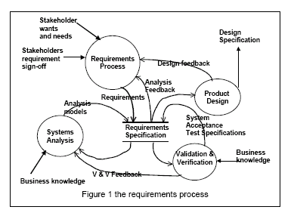
The Requirements Engineering process

Slide 16
Requirements Elicitation
Sometimes called requirements elicitation or requirements discovery
Involves technical staff working with customers to find out about the application domain, the services that the system should provide and the system’s operational constraints
May involve end-users, managers, engineers involved in maintenance, domain experts, trade unions, etc. These are called stakeholders

Slide 17
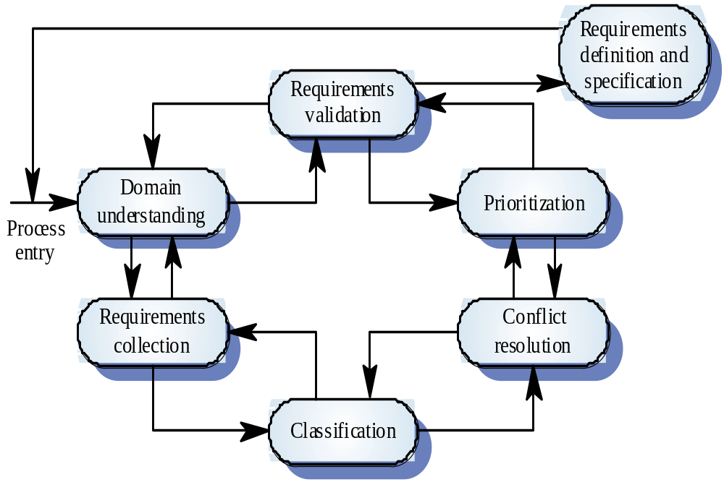

Slide 18
Problems with Requirements Elicitation
Problems of scope
Problems of understanding
Problems of volatility

Slide 19
Guidelines for Requirements Elicitation
Assess business and technical feasibility
Identify the people
Define the technical environment
Identify “domain constraints”
Define one or more requirements elicitation methods
Solicit participation from many people
Identify ambiguous requirements
Create usage scenarios

Slide 20
Work products
Statement of need and feasibility
Bounded statement of scope
List of customers, users, and other stakeholders
Description of system’s technical environment
List of requirements and domain constraints
Set of usage scenarios
Any prototypes

Slide 21
Requirements Analysis and Negotiation
Definition of Analysis
  an investigation of the component parts of a whole and their relations in making up the whole
  the abstract separation of a whole into its constituent parts in order to study the parts and their relations
Definition of Requirements Analysis
  the requirements engineering task during which elicited requirements are studied, analyzed, modeled, and refined in order to ensure that they are complete, consistent, understandable, etc. when specified.
  www.donald-firesmith.com/Glossary/GlossaryR.html

Slide 22
Analysis categorizes requirements and organizes them into related subsets; explores each requirement in relationship to others; examines requirements for consistency, omissions, and ambiguity; and ranks requirements based on the needs of customers/users.

Slide 23
Requirements Negotiation
Definition
  A discussion intended to produce an agreement http://www.cogsci.princeton.edu/cgi-bin/webwn?stage=1&word=negotiation
  Discussion, written or otherwise, between two or more parties on different sides, the aim being to reach a common agreement.
  www.merlinprojects.com/misc/glossary.htm
Reconcile conflicts, rank requirements and then discuss conflicts according to priority.
Risks identified and analyzed
Rough guestimates of development effort are made and used to assess the impact of each requirement on project cost and delivery time.
Requirements are eliminated, combined, and/or modified

Slide 24
Requirements Specification
Definition of specification
  A specification can be a written document, a graphical model, a formal mathematical model, a collection of usage scenarios, a prototype, or any combination of these. [Pressman]
  A document that states the requirements to which a given product or service must conform.
  www.asq.org/info/glossary/s.html

Slide 25
System Specification
Final work product
Describes
  Function and performance of a computer-based system and the constraints that will govern its development.
  Information that is input to and output from the system.

Slide 26
System Modeling
What?
  Blueprint or three-dimensional rendering
Why?
  Easy to assess the efficiency of work flow
  Important to evaluate the system’s components in relationship to one another
  Determine how requirements fit into this picture
  Assess the “aesthetics” of the system

Slide 27

Requirements Validation
Definition of Requirements Validation
  Examination of the specification to ensure
    System requirements have been stated unambiguously
    Inconsistencies, omissions, and errors have been detected and corrected
    The work products conform to the standards established for the process, the project, and the product.

Slide 28
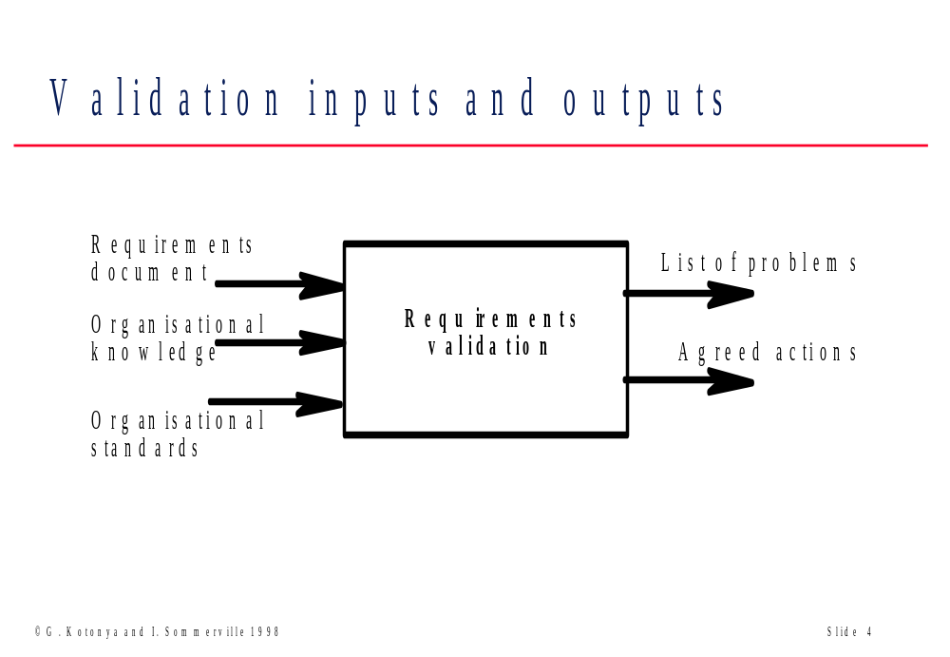

Slide 29
Requirements Validation
The primary requirements validation mechanism is THE FORMAL TECHNICAL REVIEW.

Slide 30
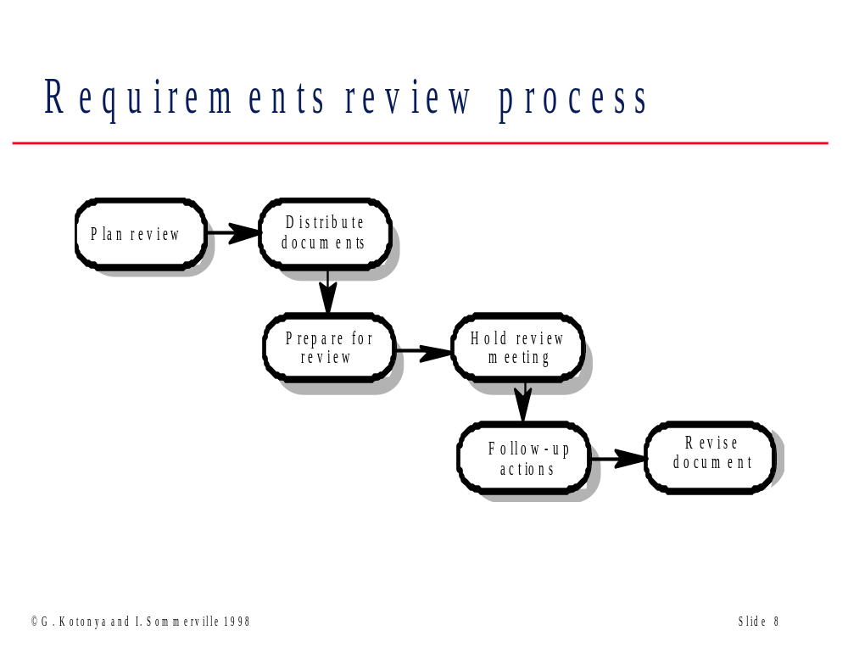

Slide 31
Requirements Management
Definition of Requirements Management
  Requirements management is a set of activities that help the project team to identify, control, and track requirements and changes to requirements at any time as project proceeds

Slide 32
Requirements Management
Traceability tables
  Features traceability table
  Source traceability table
  Dependency traceability table
  Subsystem traceability table
  Interface traceability table

Slide 33
Requirements Elicitation and Analysis Methods
View points
Scenarios
  Story boards
  Trees
Interviewing
Questionnaires
Forms analysis
Video cameras

Slide 34
Interviewing
Interviewing is an important method for collecting data on information system requirements
Interviews reveal information about
    Interviewee opinions
    Interviewee feelings
    About the current state of the system
    Organizational and personal goals
    Informal procedures

Slide 35
Planning the Interview
  Five steps in planning the interview are
    Reading background material
    Establishing interview objectives
    Deciding whom to interview
    Preparing the interviewee
    Deciding on question types and structure

Slide 36

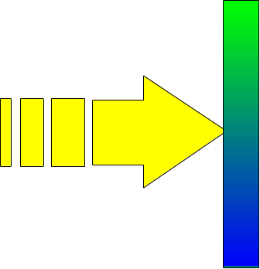

Question Types
There are two basic types of interview questions:
  Open-ended
    Open-ended interview questions allow interviewees to respond how they wish, and to what length they wish
  Closed
    Closed interview questions limit the number of possible responses

Slide 37



Question Sequencing
There are three basic ways of structuring interviews:
  Pyramid, starting with closed questions and working toward open-ended questions
  Funnel, starting with open-ended questions and working toward closed questions
  Diamond, starting with closed, moving toward open-ended, and ending with closed questions

Slide 38
Structured and Unstructured Interviews
A completely structured interview is planned and the plan is strictly followed
Closed questions are the basis of structured interviews
An unstructured interview is conversational

Slide 39
Before the Interview
Contact the interviewee and confirm the interview
Dress appropriately
Arrive a little early
Affirm that you are present and ready to begin the interview

Slide 40

Beginning the Interview
Shake hands
Remind them of your name and why you are there
Take out note pad, tape recorder
Make sure tape recorder is working correctly

Slide 41
Opening Questions
Start with pleasant conversation, open-ended questions
Listen closely to early responses
Look for metaphors

Slide 42

During the Interview
The interview should not exceed 45 minutes to one hour
Make sure that you are understanding what the interviewee is telling you
Ask for definitions if needed
Use probing questions

Slide 43
Closing the Interview
Always ask “Is there anything else that you would like to add?”
Summarize and provide feedback on your impressions
Ask whom you should talk with next
Set up any future appointments
Thank them for their time and shake hands

Slide 44
Questionnaires
Questionnaires are useful in gathering information from key organization members about
  Attitudes
  Beliefs
  Behaviors
  Characteristics

Slide 45
Questionnaire Language
Questionnaire language should be
  Simple
  Specific
  Free of bias
  Not patronizing
  Technically accurate
  Addressed to those who are knowledgeable
  Appropriate for the reading level of the respondent

Slide 46
Sampling
Sampling is a process of systematically selecting representative elements of a population
Involves two key decisions
  Which of the key documents and Web sites should be sampled
  Which people should be interviewed or sent questionnaires

Slide 47
Scenarios
Scenarios are descriptions of how a system is used in practice
They are helpful in requirements elicitation as people can relate to these more readily than abstract statement of what they require from a system
Scenarios are particularly useful for adding detail to an outline requirements description

Slide 48
Scenario descriptions
System state at the beginning of the scenario
Normal flow of events in the scenario
What can go wrong and how this is handled
Other concurrent activities
System state on completion of the scenario

Slide 49
Scales
Scales are devised to
  Measure the attitudes or characteristics of respondents
  Have respondents act as judges for the subject of the questionnaire

